Slide 1
Object Following with PuppyPi

Slide 2
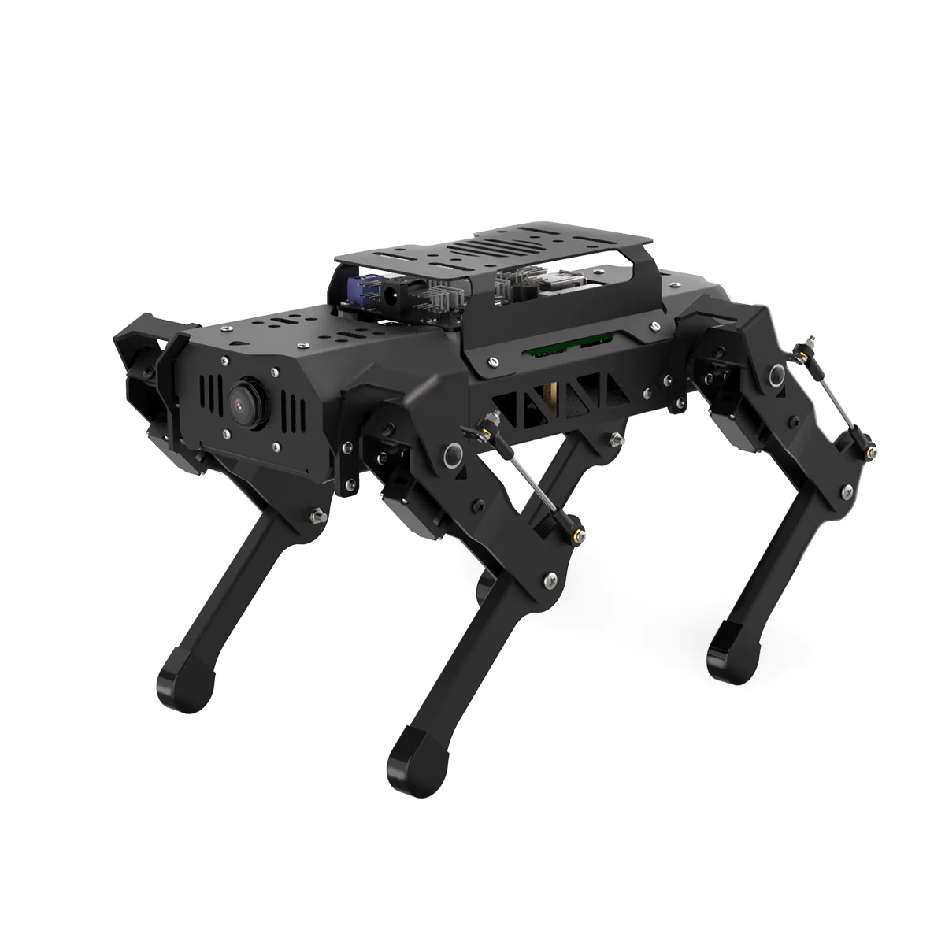
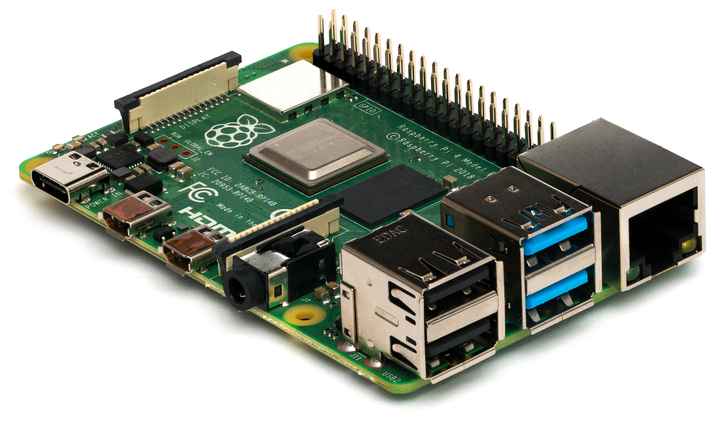
Introduction
The PuppyPi is a quadruped robotic platform by Hiwonder built on the Raspberry Pi 4.
Raspberry Pi is an affordable single-board computer which is highly popular in hobbyist electronics projects, especially robotics!

Slide 3
Introduction
In this demonstration, we want to leverage machine learning principles and train a model for real-time application.
In contrast to previous lessons, here we will explore more of the machine learning pipeline:
Collecting and labeling data
Training and validating the model
Integrating our model into system for real-time prediction
Let’s make the PuppyPi follow an object using machine learning!

Slide 4
Introduction - Robotics
For a robotic system to interact with its environment, it needs to perform two tasks:
Sensing – using one or more sensors (e.g. camera, LiDAR), the robot needs to make observations about its environment.
Control – based on its sensor measurements, make some decision and perform an appropriate action.
Sensor measurements (e.g. picture)
Sensing
Control
Action changes environment: measure again
Action
(e.g. move left)
Environment

Slide 5
Introduction - Robotics
An ML model, which takes in sensor data and produces a prediction about the environment, fits best under control!
Sensor measurements (e.g. picture)
Sensing
Model Prediction and Control
Action changes environment: measure again
Action
(e.g. move left)
Environment

Slide 6
Introduction – ML Model
Using the camera provided with the PuppyPi, we can collect images and train a model to detect the object, then run it on the Pi and let the model predictions guide where the robot moves!
Problem:
Machine learning is computationally intensive, requiring powerful GPUs.
Raspberry Pi is limited in computational power.
Object detection could give direction to where the object is.
However, object detection is complex, and the networks are usually large and costly.
Solution:
Multiclass classifier!

Slide 7
Introduction – ML Model
Use a multiclass classifier with different classes for different desirable actions.
If the ball is near the left/right edge of the image, turn to the left/right
If the ball is in the center of the image, move forward
If the ball is centered and close, stop.
If the ball is not in sight, circle and look for it.
A classifier with classes representing those 5 states (left, right, center, close, no ball) will let us choose the correct decisions without really locating the ball.

Slide 8
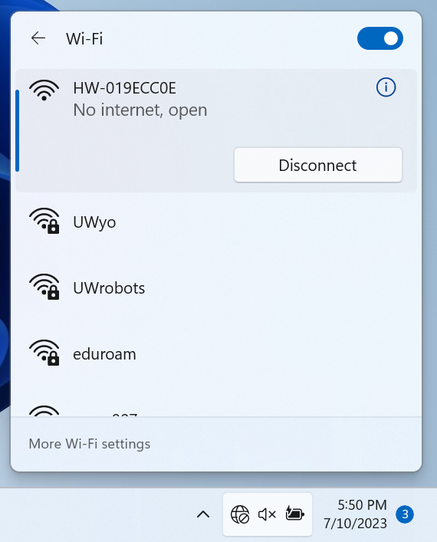
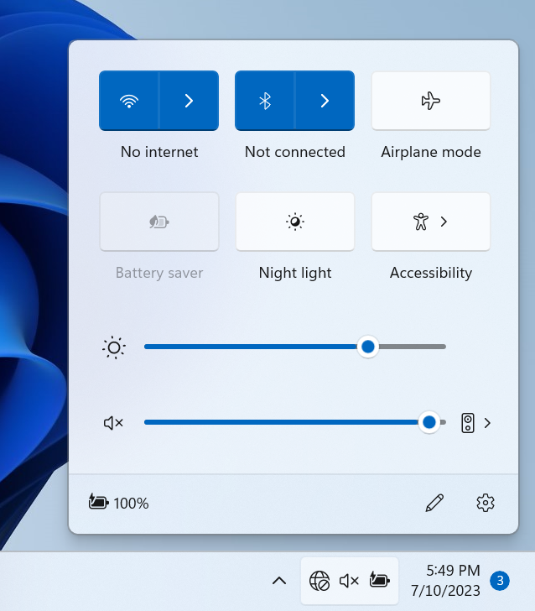
Data Collection
Set PuppyPi on the floor and press the power switch.
Make note of the number printed on your Puppy:
HW-########
This is the name of the Wi-Fi network belonging to your robot
Connect to that network when it appears
Choose number from your robot!

Slide 9
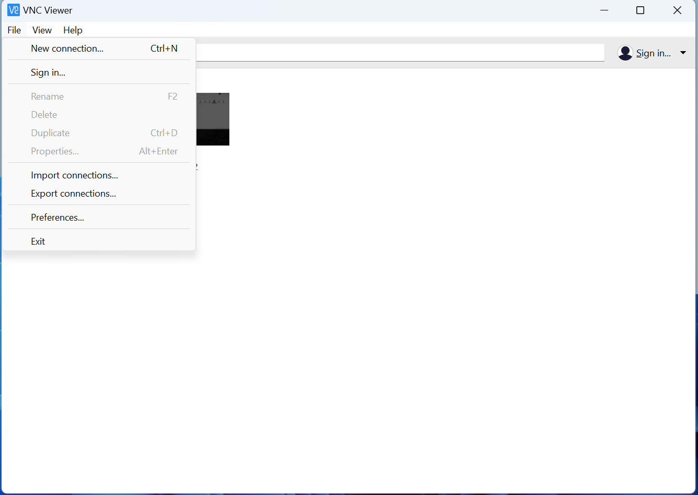
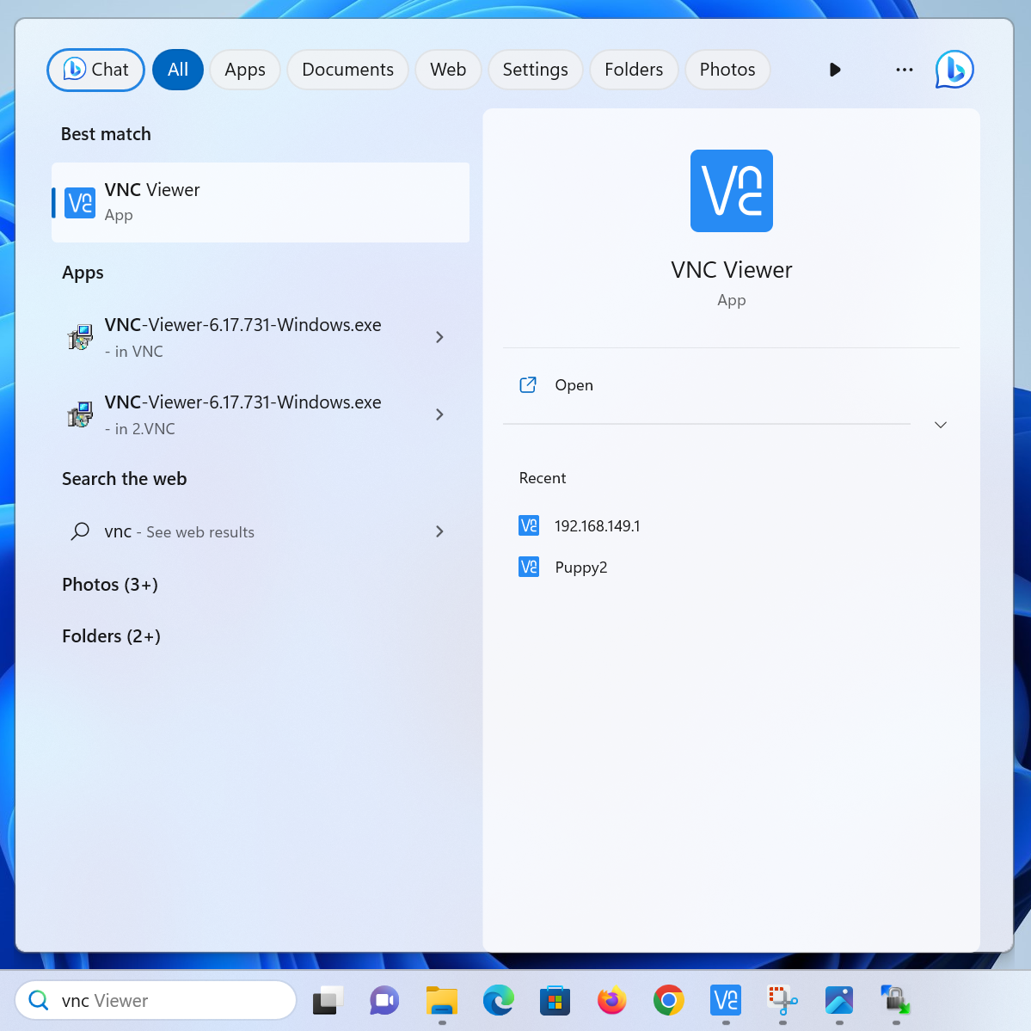
Data Collection
Open VNC viewer
File -> New Connection

Slide 10
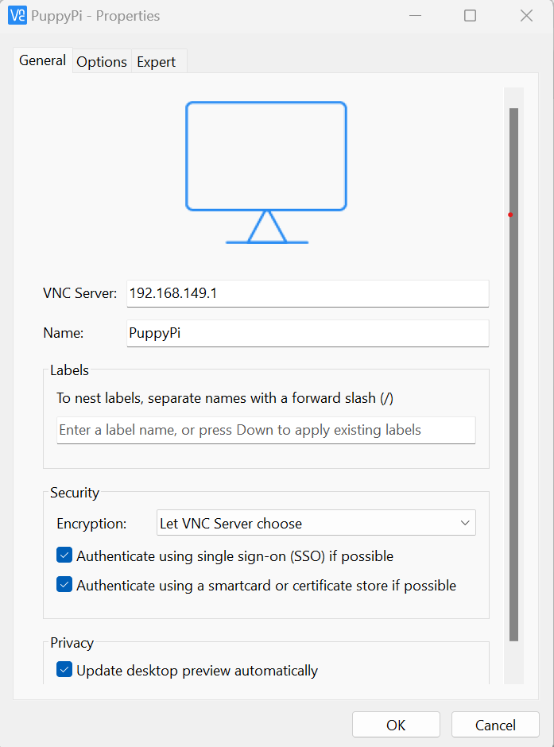
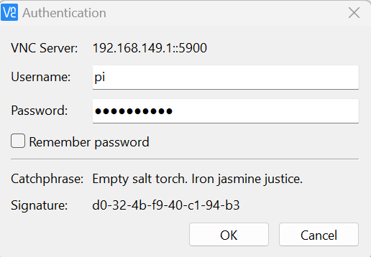
Data Collection
Fill out information as shown
ml4hst2023

Slide 11
Data Collection
Once you run the collection script, the Pi will take a picture every 0.5 seconds approximately.
One person in your group should move the ball around.
Another person should start and stop the script after about 15 seconds of runtime.
You are supplementing a dataset which I have already created; your data doesn’t have to be perfect!

Slide 12
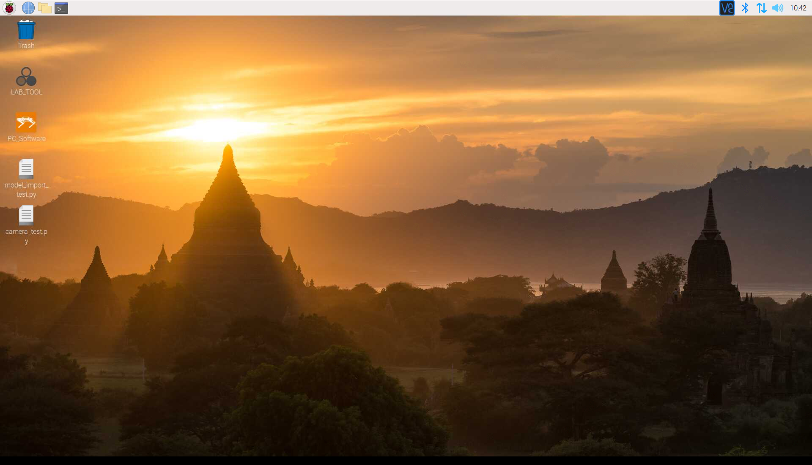
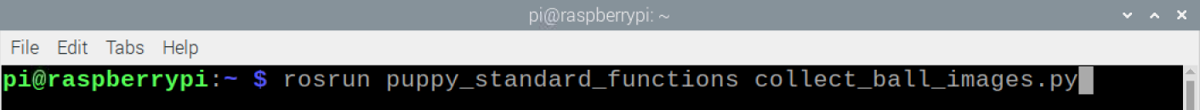
Data Collection
Once at Raspberry Pi desktop, open a terminal and run collection script as shown
* Press Ctrl+C in
terminal to stop
script
* Connect PuppyPi
to charger after
shutting down script

Slide 13
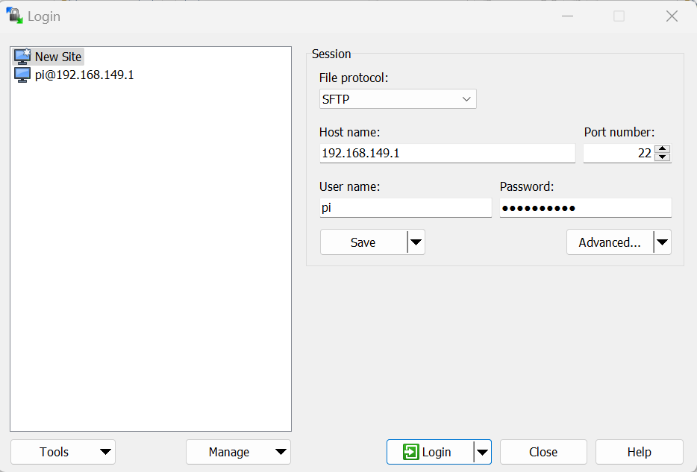

Data Collection
Back on laptop, open WinSCP to transfer training data back to computer
ml4hst2023

Slide 14
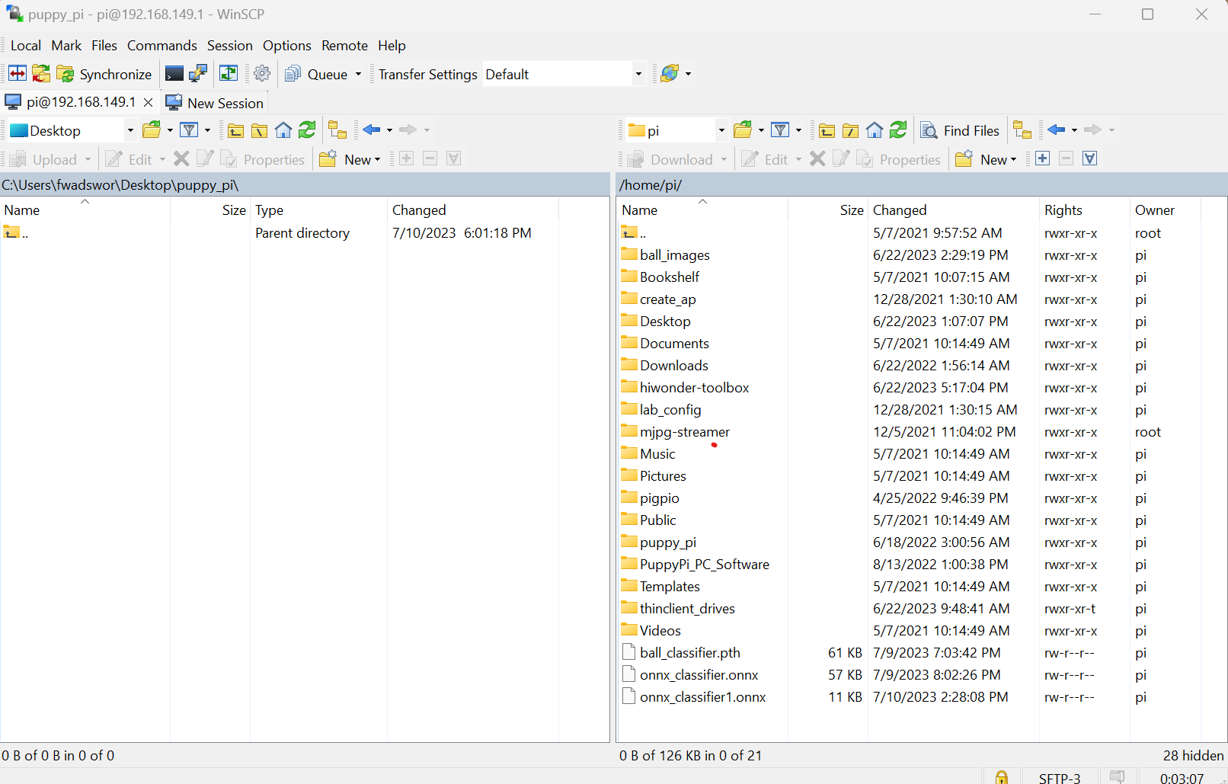
Data Collection
Transfer collected images from Pi back to laptop
Navigate to directory
C:\Users\workshop\puppy_pi\
Drag ‘ball_images’ folder into laptop

Slide 15
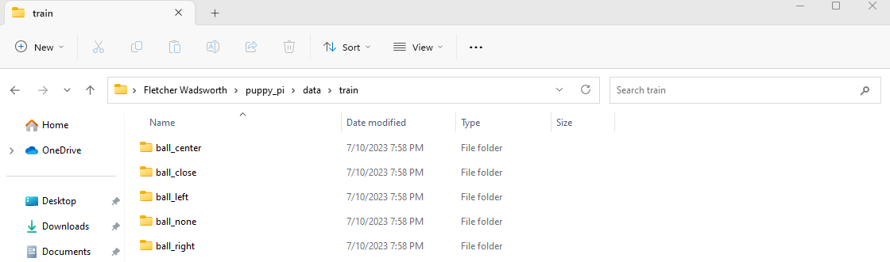
Data Labeling
Navigate to the folder you just copied to the laptop.
Open another file explorer and navigate to the ‘\data\train\’ folder in the same directory.
You need to Cut/Paste the images into the correct directory using examples on the next slide as criteria.
Labeling can be a judgement call, ask if you have questions!

Slide 16
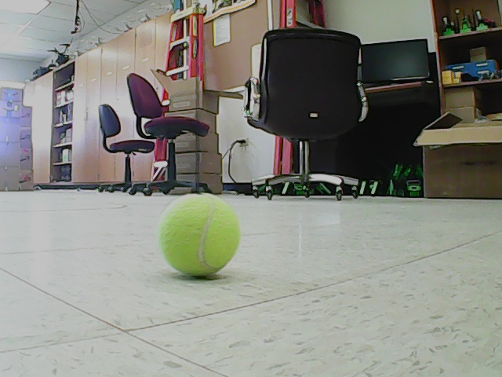
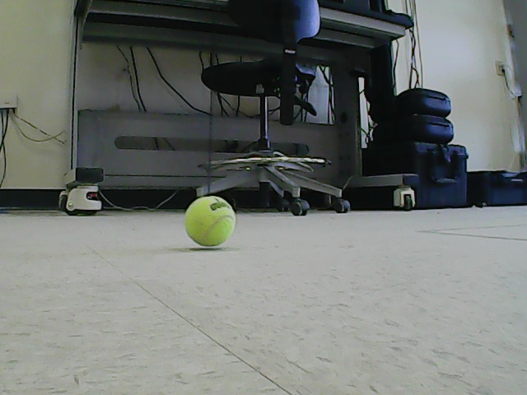
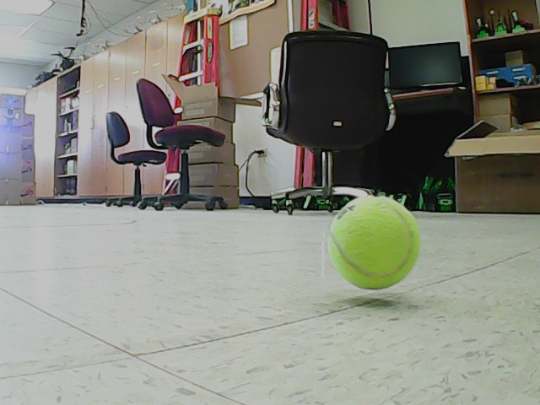
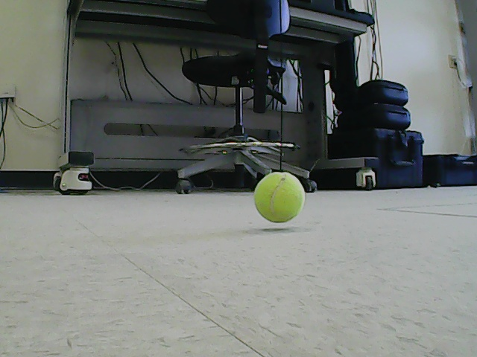
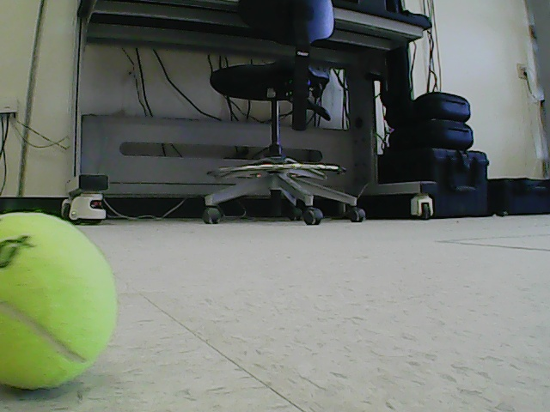
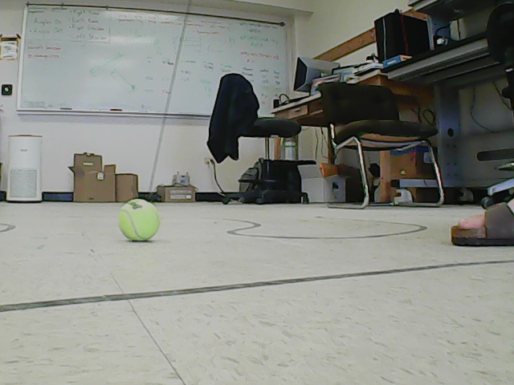
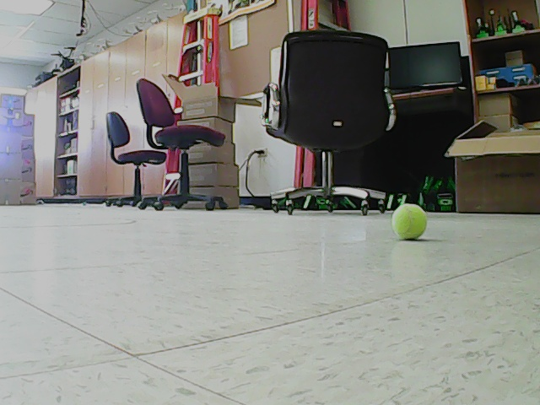
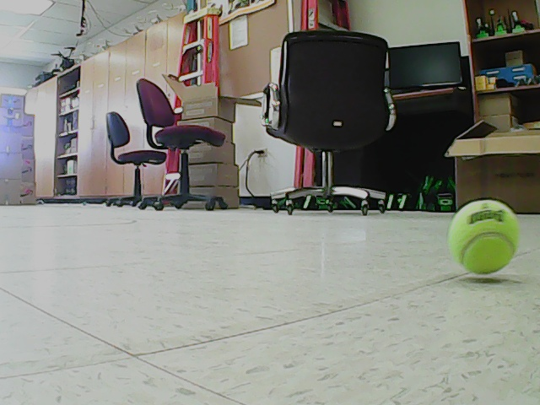
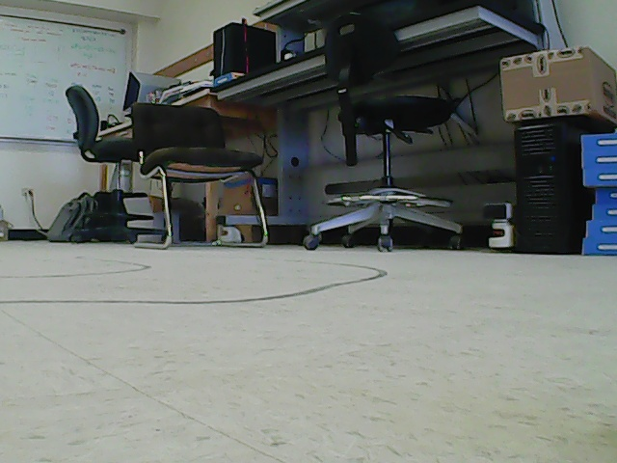

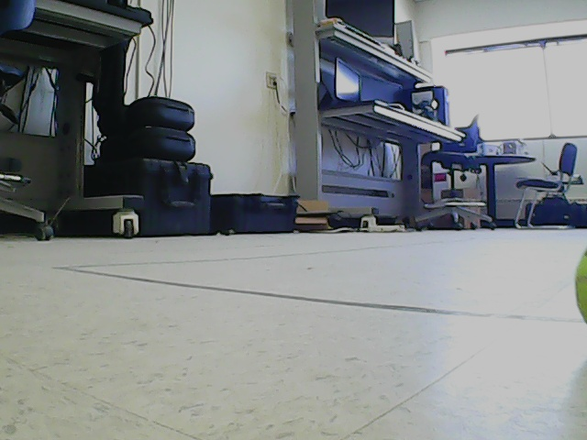
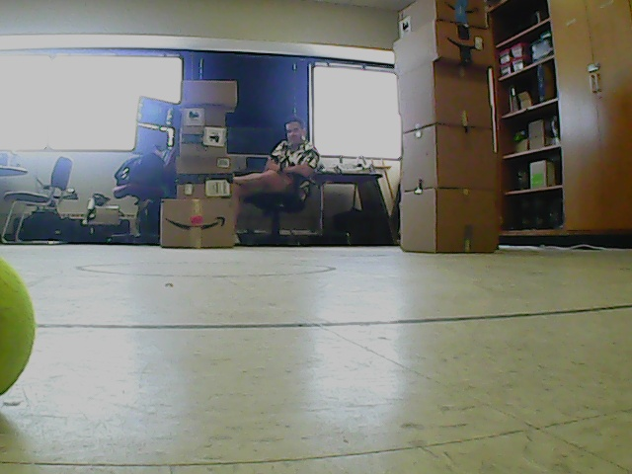
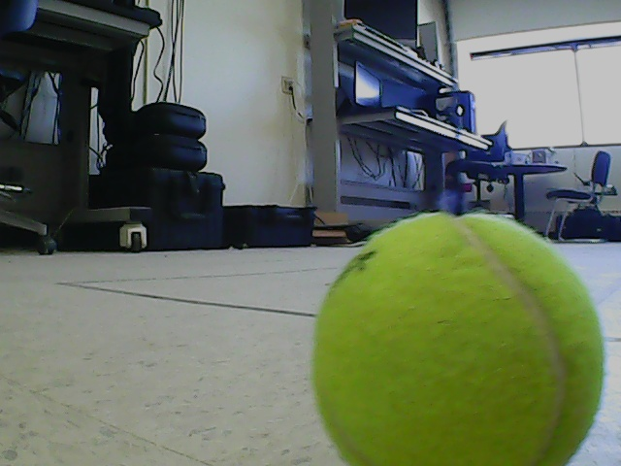
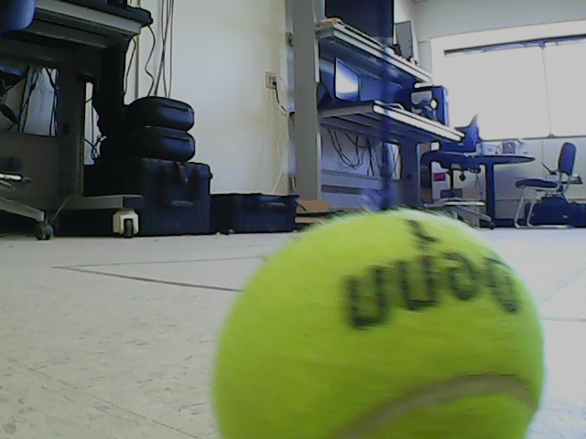
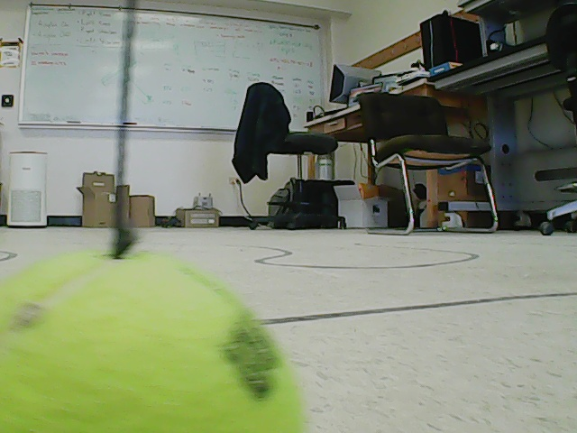
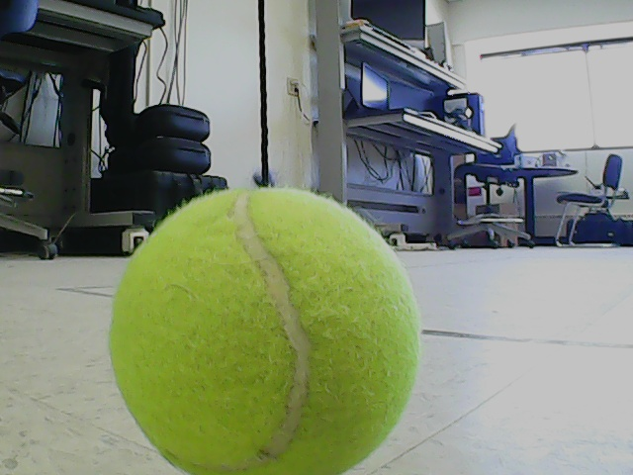
Data Labeling
ball_center
ball_left/ball_right
If ball is closer to the side than to the center
ball_none
Only if more than ~1/3 of the ball is in the image
ball_done

Slide 17
Model Training
Once you have moved all collected images into their appropriate folder, open ball_classifier_template.ipynb in a Jupyter Notebook.
Cell 1 imports our necessary libraries and modules.
Cell 2 sets up our data sets and data loaders.
These cells don’t need any code from you!

Slide 18
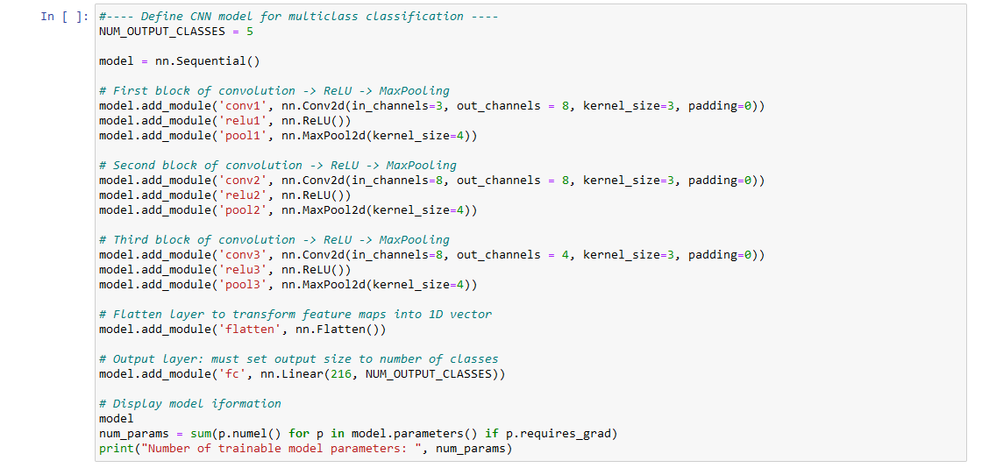
Model Training
Cell 3 defines our CNN network layers. Complete this cell as shown:
Use Copy/Paste, just change the names and parameters appropriately!

Slide 19
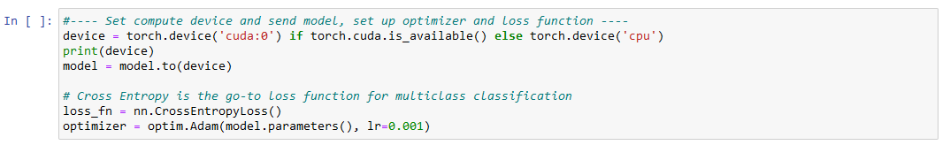
Model Training
Cell 4 defines our compute device, loss function, and optimizer.
Complete the cell as shown

Slide 20
Model Training
Cell 5 defines our training loop. This is already complete for you!
Cell 6 calls our training loop function. Complete as follows:
Cell 7 saves our model to an ONNX file.
This is a protocol for storing neural network models and sharing them between Deep Learning platforms.
We’ll read the network on the PuppyPi from this file!
Cell 7 needs no code from you.

Slide 21
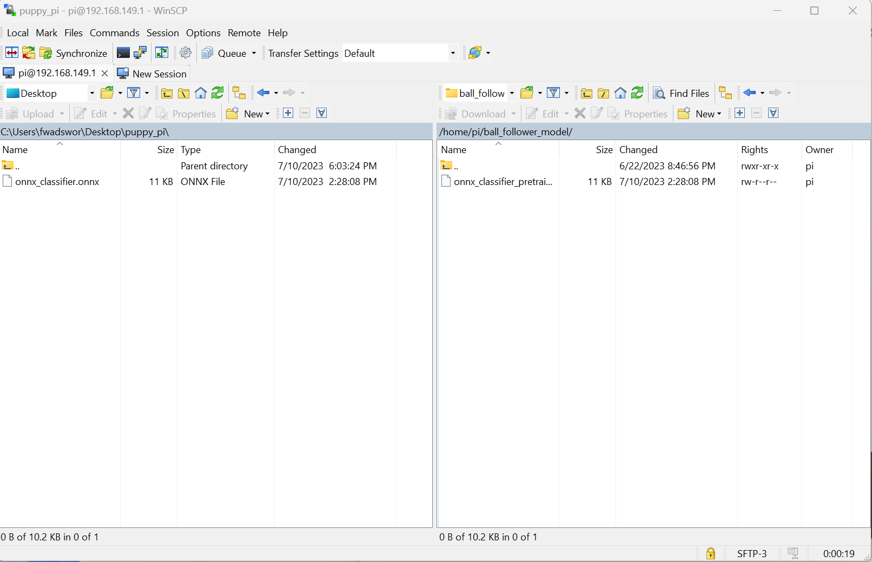
Model Training
Back in WinSCP, transfer the newly created onnx_classifier.onnx file back to the Pi.
This file is in the same directory as the Jupyter Notebook.
Place it in /home/pi/ball_follower_model/

Slide 22
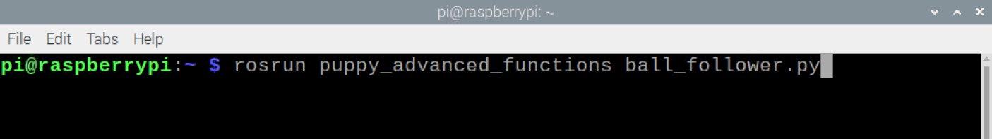
Real-Time Model Prediction
Place your PuppyPi back on the ground and get ready with the ball!
Open a terminal and run the following command:

Slide 23
Real-Time Model Prediction
Issues:
Classifier instead of object detection
Labeling is ambiguous.
No precise idea where ball is and how much to move.
Integrating robot sensing and control
Synchronizing sensing and actions to run smoothly is actually quite difficult.
Due to limitations in Raspberry Pi’s computing power, and even the Python language itself, sensing and actions fall out of sync.

Slide 24
Lessons Learned
For robotic applications, compute power of embedded devices are a constraint.
The Jetson Nano (JetHexa) could do this task much better, but is more expensive and less user-friendly during development than Raspberry Pi.
Training a ML model isn’t even half the battle
Data collection, labeling, and organization require a lot of time.
The code for using the model prediction is often much more complex than the model itself.
Despite the computational limitations, adapting our model still allows us to play with machine learning in robotics!

